Slide 1
ClauseIQ
Machine Learning-Based Contract Clause Classification
& Intelligent Search System
DEVELOPED BY:
Mohammed Farhan K
Register No: MAC25MCA-2042
Department of Computer Applications
PROJECT GUIDE:
Dr. Sonia Abraham
Associate Professor, Department of Computer Applications
Mar Athanasius College of Engineering, Kothamangalam | August 2026
Notes:
Good morning everyone. I am Mohammed Farhan K, a student of the MCA Department at Mar Athanasius College of Engineering. Today, I am presenting the first stage of my Mini Project titled 'ClauseIQ -- Machine Learning-Based Contract Clause Classification and Intelligent Search System'. This project is supervised by my guide, Dr. Sonia Abraham. This presentation will cover the problem statement, objectives, literature review, dataset analysis, exploratory data analysis, preprocessing, chosen machine learning algorithms, flowcharts, pseudocodes, system architecture, and our proposed GUI design.

Slide 2
PROBLEM STATEMENT
Why Manual Legal Document Analysis is Insufficient
1. Volume & Fatigue
• Organizations handle thousands of active commercial contracts.
• Reviewing agreements manually is slow, repetitive, and mentally draining.
• Fatigue leads to critical omissions, such as missed obligations or liabilities.
2. Keyword Search Limitations
• Generic text searches (Ctrl+F) rely on exact literal character matches.
• Legal clauses use diverse syntactic phrasing to convey the same legal concept.
• A search for 'Liability Limit' fails to locate 'indemnification caps' or 'max exposure'.
3. Structural Variation
• Legal agreements are unstructured and lack a standardized layout.
• Critical provisions are embedded inside covenants, appendices, or split sections.
• Result: Due diligence reviews create business bottlenecks and cost massive billable hours.
ClauseIQ -- Machine Learning-Based Contract Clause Classification and Intelligent Search
Dept. of Computer Applications, MACE | Slide 2
Notes:
Let's look at the core problem. Commercial organizations deal with a massive volume of active legal contracts. Manual analysis of these documents is slow and prone to cognitive errors, potentially exposing companies to compliance risks. Standard keyword search is literal and doesn't capture semantics. A query for 'Liability Limit' will miss clauses that refer to 'aggregate exposure limit' or 'indemnity cap'. Contracts also lack a standardized structure. This creates high operational costs and delays. ClauseIQ addresses this by automating clause classification and similarity-based retrieval.

Slide 3
PROJECT OBJECTIVES
Main Deliverables and Engineering Targets
Key Engineering Objectives
• PDF Text Extraction: Automatically parse and extract text from uploaded contract PDFs using PyMuPDF.
• Clause Segmentation: Split continuous, unstructured text documents into logical, bounded clause paragraphs.
• Automated Categorization: Use classical machine learning classifiers to predict which of the 41 CUAD legal categories a clause belongs to.
• Semantic Similarity Search: Vectorize search queries to rank and retrieve relevant clauses across the corpus using Cosine Similarity.
• Classifier Comparison: Empirically evaluate and compare four ML models (Naive Bayes, SVM, Logistic Regression, Random Forest).
• Professional Interface: Expose the system through a web interface with filters, viewer, and confidence scores.
Objective Highlight
The core goal is to build a lightweight, deterministic 'Contract Intelligence' pipeline that runs locally on commodity CPU hardware.
By avoiding expensive generative LLMs, we guarantee:
1. Zero hallucination risk (crucial for legal compliance).
2. Sub-millisecond inference and query times.
3. Data privacy (no external APIs used).
4. A structured benchmark using the standard CUAD dataset.
ClauseIQ -- Machine Learning-Based Contract Clause Classification and Intelligent Search
Dept. of Computer Applications, MACE | Slide 3
Notes:
Our project has six key engineering objectives: First, parse and extract text from PDFs. Second, segment unstructured text into clauses. Third, classify clauses automatically into 41 predefined CUAD categories. Fourth, implement a similarity-based search engine. Fifth, evaluate and compare four classical ML algorithms. Sixth, build a clean dashboard interface. We emphasize lightweight, deterministic local processing to preserve privacy, eliminate hallucination risks, and keep the application computationally lightweight, fitting within the MCA Mini Project scope.

Slide 4
LITERATURE REVIEW
Comparison of Supporting IEEE Publications
Paper Reference & Year | Methodology Used | Key Findings & Advantages | Methodological Limitations | Relation to ClauseIQ
Quevedo et al. [1] (IEEE Access, 2024) | Systematic Mapping Study of Legal NLP (2015-2022) reviewing 75 pivotal articles. | Categorized legal tasks (Multiclass classification, QA); identified critical datasets including CUAD; mapped research trends. | Review paper only; no new empirical code implementation or benchmark performance analysis. | Validates contract clause extraction as a primary, well-studied sub-task in Legal NLP.
Siino et al. [2] (IEEE Access, 2025) | Systematic Literature Review of 61 papers mapping LLM & Transformer usage. | Confirms GPT/Transformer success in legal document summarization, contract review, and outcome prediction. | Identified severe risks: model hallucinations, high computational costs, and privacy concerns. | Justifies our decision to build classical ML models first to avoid costs and hallucinations.
Kutbi [3] (IEEE Access, 2023) | spaCy NER pre-processor that tags and replaces entities with generic category labels. | Replacing names/dates with tokens (<PERSON>, <DATE>) improves text classification accuracy and preserves privacy. | Requires pre-trained NER; simple tag replacement might lose subtle semantic context in some legal domains. | Validates the use of text preprocessing and spaCy for legal data cleaning.
RESEARCH GAP IDENTIFIED:
While current literature focuses heavily on large black-box deep learning structures (e.g. LLMs) that require massive GPUs, there is a gap in lightweight, explainable, and deterministic legal tech applications. ClauseIQ addresses this by implementing a classical, length-normalized TF-IDF and supervised classification pipeline that runs efficiently on standard computers, preserving privacy while delivering explainable category distributions.
ClauseIQ -- Machine Learning-Based Contract Clause Classification and Intelligent Search
Dept. of Computer Applications, MACE | Slide 4
Notes:
Our literature review covers three recent IEEE papers. Quevedo et al. (2024) provide a mapping study that validates contract clause classification as a core Legal NLP task. Siino et al. (2025) review LLM applications in law, highlighting risks like hallucinations, privacy, and compute costs, which justifies our choice of deterministic classical ML. Kutbi (2023) shows that replacing named entities with generic tokens in preprocessing increases classification accuracy and preserves privacy. The research gap is the lack of lightweight, explainable, local systems, which ClauseIQ addresses.

Slide 5
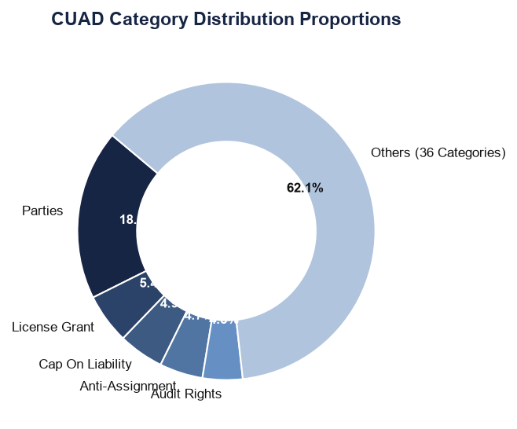
DATASET ANALYSIS
CUAD: Contract Understanding Atticus Dataset
Dataset Characteristics
• Sourcing: Created by The Atticus Project, a non-profit legal tech group.
• Corpus Size: 510 real commercial contracts drawn from the SEC EDGAR filing database.
• Legal Classes: 41 distinct categories that lawyers routinely review in transactional due diligence.
• Annotation Quality: Manually annotated by legal experts, resulting in 13,000+ labeled clause spans.
• Project Flattening: The raw SQuAD-style JSON file (CUADv1.json) was parsed and flattened into a clause-level CSV, yielding 13,823 distinct rows.
• License: Distributed under Creative Commons Attribution 4.0 (CC BY 4.0).
ClauseIQ -- Machine Learning-Based Contract Clause Classification and Intelligent Search
Dept. of Computer Applications, MACE | Slide 5
Notes:
For dataset analysis, we utilize the Contract Understanding Atticus Dataset (CUAD), which is a public, expert-annotated legal NLP benchmark. It consists of 510 real commercial contracts from the SEC EDGAR database, with over 13,000 manually annotated clause spans across 41 categories. We flattened this QA dataset into a structured CSV, yielding 13,823 clauses. The pie chart on the right displays the class distribution. We notice a strong imbalance: the largest class 'Parties' accounts for 18.5% of the dataset, which requires class-balancing strategies.

Slide 6
EXPLORATORY DATA ANALYSIS
Statistical Profiling and Pandas Implementations
Dataset Structure & Variables
• Shape: 13,823 rows and 5 columns.
• Columns & Types:
• contract: Object (Document filename)
• category: Object (Target legal label, e.g. Governing Law)
• clause_text: Object (Raw clause string)
• char_len: int64 (Character length)
• word_count: int64 (Word count)
• Missing Values: 0 null values across all columns.
• Duplicates: 0 duplicate text spans (following flattening).
• Clause Length: Highly right-skewed.
• Mean: 40.7 words, Median: 31 words, Max: 479 words.
Python Pandas Statistical Operations
The exploratory pipeline utilizes several core Pandas functions:
• head() & tail(): Inspect start and end rows to verify structural parsing.
• info(): Print non-null counts and memory usage.
• shape: Check dataset dimensions.
• describe(): Calculate descriptive statistics (mean, std, min, max, quantiles) for length analysis.
• value_counts(): Quantify frequency distributions for all 41 categories, mapping the class imbalance.
Conclusions:
1. Skewed lengths mean we must use length-normalized TF-IDF features rather than raw word counts.
2. Severe class imbalance requires stratified train-test splits and weighted loss functions in the model.
ClauseIQ -- Machine Learning-Based Contract Clause Classification and Intelligent Search
Dept. of Computer Applications, MACE | Slide 6
Notes:
For Exploratory Data Analysis, we profile the dataset using Pandas. The dataset contains 13,823 rows and 5 columns. We used shape to verify size, info() to confirm that there are zero missing values, and describe() to analyze clause lengths. The mean word count is 40.7, but the median is 31, with a long tail up to 479 words. This right-skewed distribution justifies length-normalized TF-IDF vectorization. We used value_counts() to profile the 41 categories, showing a severe class imbalance ranging from 2,554 'Parties' samples down to 27 'Price Restrictions' samples, which necessitates a stratified train-test split.

Slide 7
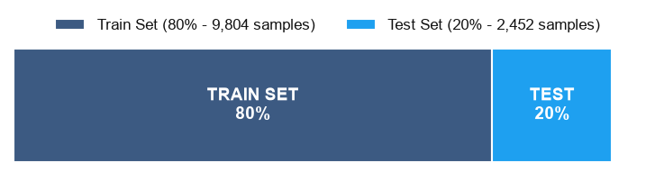
DATA PREPROCESSING PIPELINE
Text Cleaning, Normalization and Feature Engineering
Raw Text
Text Cleaning
Tokenization
Lemmatization
TF-IDF Vectorizer
Feature Matrix
Text Cleaning & Normalization
• Text Cleaning: Convert text to lowercase, collapse redundant whitespaces, and remove non-legal characters.
• Short Span Filtering: Remove clauses with fewer than 3 tokens (e.g. party name fragments) which represent noise. Cleaned dataset has 12,256 rows.
• Tokenization & Lemmatization: Segment sentences into words and resolve words to base dictionary forms (lemmas) using spaCy, reducing vocabulary sparsity.
• Stopword Removal: Remove common English stopwords to focus features on content-rich terms.
Feature Extraction & Train-Test Split
• TF-IDF Configuration:
• Vocabulary capped at 5,000 terms.
• n-gram range set to (1,2) to capture bigrams (e.g. 'prior written').
• min_df=2 to ignore one-off typos or unique entity names.
• Vector Normalization: L2 normalization is applied to handle variable length.
• Stratified Train-Test Split (80:20):
• 9,804 training samples, 2,452 test samples.
• Stratification ensures rare categories are represented in both sets.
• Imbalance Handling: Model training utilizes balanced class weights.
ClauseIQ -- Machine Learning-Based Contract Clause Classification and Intelligent Search
Dept. of Computer Applications, MACE | Slide 7
Notes:
This flowchart outlines our data preprocessing steps. The raw text goes through text cleaning (case normalisation and noise stripping), short-span filtering, tokenization, and lemmatization using spaCy. We then convert the text to numerical features using TF-IDF. We extract unigrams and bigrams, cap the vocabulary at 5,000 terms, and use L2 normalization to handle variable clause lengths. Finally, we split the corpus into an 80% training set and a 20% test set. We use a stratified split to ensure that all 41 categories, even the rarest ones, are represented proportionally in both sets.

Slide 8
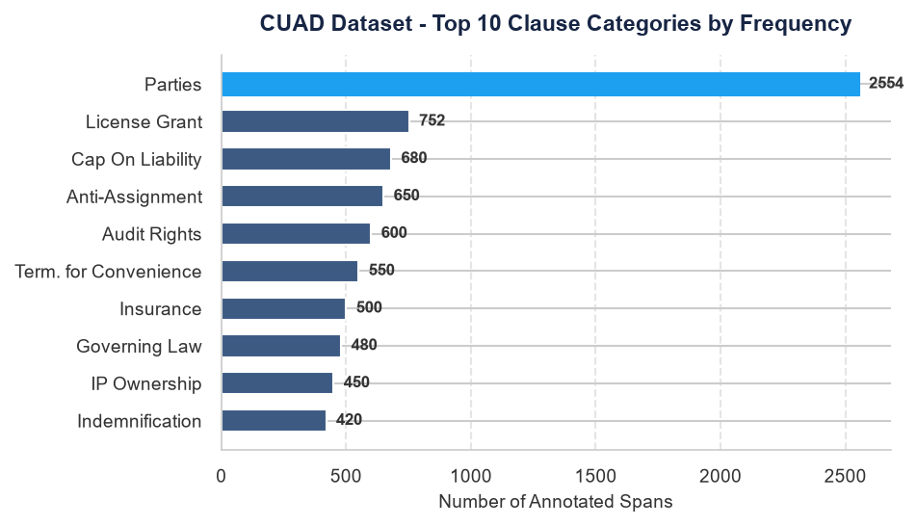
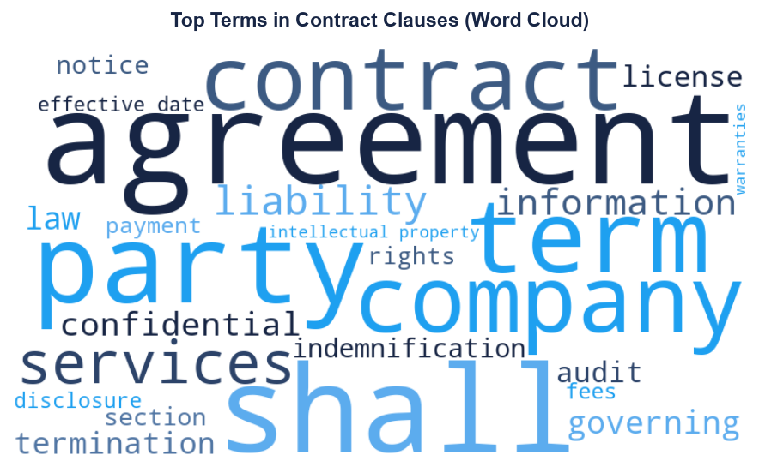
DATA VISUALIZATION ANALYSIS
Exploratory Charts of the Cleaned Clause Corpus
INSIGHTS FROM DATA VISUALIZATION:
• Left Bar Chart: Displays severe class imbalance (the top 10 categories account for the majority of the dataset). This necessitates macro-F1 and class weighting. • Right Word Cloud: Highlights the dominance of common legal terms ('shall', 'agreement', 'party', 'confidential'). This justifies why bigrams and TF-IDF are used to capture specific contexts and down-weight boilerplate terms. • Python Libraries Used: Matplotlib, Seaborn, and WordCloud.
ClauseIQ -- Machine Learning-Based Contract Clause Classification and Intelligent Search
Dept. of Computer Applications, MACE | Slide 8
Notes:
This slide presents the results of our data visualization analysis. On the left, the horizontal bar chart illustrates the top 10 categories, highlighting the strong class imbalance, with 'Parties' being the dominant class. On the right, the Word Cloud shows the most common terms in the contracts. We see high frequencies of boilerplate legal terms like 'shall', 'agreement', 'party', 'confidential', and 'liability'. This visualizes why unigrams alone are insufficient and bigrams are needed to capture category-specific context. These charts were generated using Matplotlib, Seaborn, and the WordCloud libraries.

Slide 9
MACHINE LEARNING ALGORITHMS
Working Principles and Selections for Classification
1. Logistic Regression
• Working: Fits a linear boundary using the Softmax function for multi-class classification.
• Advantages: Fast training, handles high dimensions, provides probability scores (confidence).
• Disadvantages: Assumes linear decision boundary.
• Why Selected: Strong baseline that outputs classification confidence.
2. Support Vector Machine
• Working: Finds the maximum-margin separating hyperplanes using a Linear Kernel in a One-vs-Rest setup.
• Advantages: Highly effective in high-dimensional text classification (sparse TF-IDF vectors).
• Disadvantages: High training latency on large datasets.
• Why Selected: Linear classifiers perform exceptionally well on sparse text data.
3. Multinomial Naive Bayes
• Working: Probabilistic classifier using Bayes' Theorem with feature independence assumption.
• Advantages: Extremely fast to train, low memory, handles sparse feature vectors.
• Disadvantages: Assumption of independent word frequencies is unrealistic.
• Why Selected: Traditional baseline for text classification tasks.
4. Random Forest
• Working: Ensemble classifier that aggregates predictions from multiple decision trees.
• Advantages: Non-linear relationships, robust to noisy terms.
• Disadvantages: High memory footprint, slower inference.
• Why Selected: Evaluates ensemble performance against linear models.
ClauseIQ -- Machine Learning-Based Contract Clause Classification and Intelligent Search
Dept. of Computer Applications, MACE | Slide 9
Notes:
We select four classical machine learning algorithms. Multinomial Naive Bayes serves as our simple baseline. Linear SVM is chosen because text classification problems are often linearly separable in high-dimensional spaces, and SVMs handle sparse TF-IDF vectors exceptionally well. Logistic Regression provides class probability distributions, which is useful for indicating prediction confidence to the user. Random Forest is selected as an ensemble method to capture non-linear interactions between terms.

Slide 10
ALGORITHMIC COMPARISON STRATEGY
Comparative Parameters and Scientific Rationale
Algorithm | Training Speed | Accuracy | Interpretability | Memory Usage | Best Use Case
Multinomial Naive Bayes | Extremely Fast | Moderate | Very High (Probabilities) | Extremely Low | Lightweight Baseline
Linear SVM | Fast / Moderate | Very High | Moderate (Weights) | Low | Sparse High-Dim Text
Logistic Regression | Fast | High | High (Coefficients) | Low | Explainable Triage
Random Forest | Slow | Moderate-High | Moderate (Feature Importance) | High | Non-linear Ensembles
Scientific Rationale for Model Comparison
• High-Dimensional Separability: Text classification features are high-dimensional and sparse. Linear models (SVM, Logistic Regression) typically outperform non-linear tree-based ensembles (Random Forest) because they find cleaner decision boundaries.
• Computational Constraints: The system is designed to run locally. We compare models on memory footprint and inference speed to select the best option for desktop deployment.
• Interpretability: Lawyers require explainable predictions. Comparing Naive Bayes and Logistic Regression allows us to analyze feature coefficients to explain predictions.
ClauseIQ -- Machine Learning-Based Contract Clause Classification and Intelligent Search
Dept. of Computer Applications, MACE | Slide 10
Notes:
This comparison grid highlights the trade-offs of each model. While Random Forest is robust, it has a larger memory footprint and slower training speeds. Linear SVM and Logistic Regression are computationally efficient and perform exceptionally well on sparse, high-dimensional TF-IDF matrices. Comparing multiple classifiers allows us to empirically determine the optimal balance of accuracy, memory footprint, and inference speed, ensuring that ClauseIQ remains explainable and lightweight for local desktop deployment.

Slide 11
SYSTEM FLOWCHART
Functional Diagram of User Interactions and Pipeline Execution
6. ML Classifier
Clause
Category
1. PDF Upload
2. Text Extraction
3. Clause Segmentation
4. Data Cleaning
5. TF-IDF Extraction
7. Search Engine
Ranked
Results
PROCESS EXPLANATION:
1. Document Ingestion: The user uploads a PDF contract. Text is extracted via PyMuPDF.
2. Segmentation & Cleaning: Unstructured text is split into paragraphs and cleaned using text normalisation.
3. Vectorization: Clauses are converted to numeric representations in the TF-IDF space.
4. Parallel Engines: The features feed into two components: (i) the ML Classifier (predicts one of 41 categories) and (ii) the Search Engine (calculates cosine similarity scores to return ranked results based on user queries).
ClauseIQ -- Machine Learning-Based Contract Clause Classification and Intelligent Search
Dept. of Computer Applications, MACE | Slide 11
Notes:
This slide displays the system flowchart. The process starts when the user uploads a contract. PyMuPDF extracts the raw text. Next, the text is segmented into distinct clauses and cleaned. We transform the cleaned text into numerical features using TF-IDF. This vectors are sent to two modules: the ML Classifier (predicts the category and outputs confidence scores) and the Search Engine (compares queries using Cosine Similarity and displays ranked results).

Slide 12
SYSTEM PSEUDOCODE
Algorithmic Control Flow of the ClauseIQ Pipeline
START ClauseIQ_Pipeline:
1. UPLOAD PDF contract from GUI dashboard
2. EXTRACT raw text: raw_text = PyMuPDF.extract_text(uploaded_pdf)
3. SPLIT into logical segments: clauses = split_into_paragraphs(raw_text)
4. CLEAN text: clean_clauses = [lowercase_strip(c) for c in clauses if word_count(c) >= 3]
5. VECTORIZE features: corpus_vectors = tfidf_vectorizer.transform(clean_clauses)
6. FOR EACH clause_vector IN corpus_vectors:
predicted_category = trained_ml_model.predict(clause_vector)
confidence_score = trained_ml_model.predict_proba(clause_vector).max()
store_record(clause, predicted_category, confidence_score)
7. IF user_submits_search_query(query_text):
query_vector = tfidf_vectorizer.transform([query_text])
similarity_scores = cosine_similarity(query_vector, corpus_vectors)
ranked_results = sort_descending(similarity_scores)
DISPLAY ranked_results ON dashboard table
END ClauseIQ_Pipeline
ClauseIQ -- Machine Learning-Based Contract Clause Classification and Intelligent Search
Dept. of Computer Applications, MACE | Slide 12
Notes:
This pseudocode details the algorithmic flow. When a PDF is uploaded, PyMuPDF extracts the raw text. The text is segmented into distinct clauses, and short paragraphs are filtered out. We then extract features using TF-IDF. The classifier predicts the category and calculates the confidence score. Finally, if the user submits a search query, it is vectorized and ranked against the corpus using Cosine Similarity, displaying the results in the table.

Slide 13
PROJECT PIPELINE
Complete Architectural Components Workflow
Step 01
User
Step 02
React Frontend
Step 03
Flask Backend
Step 04
PDF Extraction
Step 05
ML Classifier
Step 06
Search Module
Step 07
Results Table
Pipeline Execution Details
• Client Layer: The user interacts with a React.js SPA, uploading contracts and typing natural language search queries.
• Request Handling: React sends the documents and text queries to the Flask backend via RESTful APIs.
• Text Processing: The Flask backend extracts text using PyMuPDF and handles segmentation and cleaning in Python.
• Vectorization & ML: Cleaned clauses are transformed into numerical features using the TF-IDF vectorizer and classified using scikit-learn.
• Similarity Search & Database: Cosine similarity ranks clauses against user queries, storing results in SQLite and returning JSON responses back to the React UI.
ClauseIQ -- Machine Learning-Based Contract Clause Classification and Intelligent Search
Dept. of Computer Applications, MACE | Slide 13
Notes:
This project pipeline displays our linear component workflow. The user interacts with the React frontend to upload PDFs. The frontend sends requests to our Flask backend via RESTful APIs. The backend processes the document using PyMuPDF, converts the clauses to TF-IDF vectors, performs machine learning predictions, and executes search rankings. The results are stored in SQLite and returned as JSON data to render in the user interface.

Slide 14
SYSTEM ARCHITECTURE
Interaction Layers and Data Boundaries
Client Layer (React.js)
User Interface Widgets:
• File Upload panel
• Real-time search bar
• Dynamic categories filter
• Clause interactive table
Communications:
• HTTP POST for contract files
• HTTP GET for search queries
• Receives structured JSON
Logic Layer (Flask API / Python)
Core Modules & Libraries:
1. Router/Controller Layer
• Receives files/strings; exposes REST endpoints
2. Text Processor (PyMuPDF & spaCy)
• Extracts PDF text; tokenizes & lemmatizes text
3. ML Classifier Engine
• Loads serialized joblib vectorizer & models
• Performs inference (label & confidence)
4. Search Indexer (Scikit-learn)
• Vectorizes queries; runs Cosine Similarity
Data Layer (SQLite)
SQLite Tables:
• Documents: Filenames & metadata
• Clauses: Extracted text segments
• Predictions: Predicted category labels & confidence scores
Storage:
• Local SQLite DB file
• Fast, self-contained relational storage
ClauseIQ -- Machine Learning-Based Contract Clause Classification and Intelligent Search
Dept. of Computer Applications, MACE | Slide 14
Notes:
The system architecture is structured into three layers: First, the Client Layer built with React.js, which manages user interaction. Second, the Logic Layer implemented as a Flask API in Python, which handles PDF parsing, text preprocessing, model prediction, and cosine-similarity calculations. Third, the Data Layer utilizing SQLite to store extracted text segments, prediction metadata, and confidence scores. This self-contained structure allows offline, local deployment.

Slide 15
GUI DESIGN MOCKUP
Proposed Contract Review Dashboard Interface
ClauseIQ Dashboard -- Contract Analysis & Semantic Search
MENU
[+] Upload PDF
[o] View Clauses
[?] Query Search
[*] Model Stats
[x] Settings
Upload Contract PDF
[ Drag & Drop PDF Here ]
- Accepted format: .pdf
- Max size: 25MB
Intelligent Semantic Search
Query: [ Find governing law and liability caps... ]
Extracted Clauses & Predictions Log
Clause Snippet | Predicted Class | Conf. | Action
"This Agreement governed by NY law..." | Governing Law | 98.4% | [View]
"In no event shall liability exceed $50k..."| Cap On Liability | 95.8% | [View]
"Neither party may assign rights..." | Anti-Assignment | 91.2% | [View]
ClauseIQ -- Machine Learning-Based Contract Clause Classification and Intelligent Search
Dept. of Computer Applications, MACE | Slide 15
Notes:
This slide displays a visual mockup of our proposed user interface, built directly with shapes. The layout consists of a dark blue top header bar, a slate blue left sidebar for navigation, and a main area split into cards. The left card contains a drag-and-drop file upload zone. The right card contains the similarity search engine bar. At the bottom, the results table displays the extracted clause texts, predicted categories, confidence scores, and action buttons.

Slide 16
SCREEN DETAILS
Functional GUI Components and Actions
1. Upload PDF Button
• Ingests multi-page commercial contracts.
• Accepts standard PDF files.
• Triggers text extraction and classification.
2. Search Box
• Supports natural language query strings.
• Vectorizes input in the TF-IDF space.
• Returns cosine similarity results.
3. Clause Viewer
• Scrollable table presenting clause text.
• Highlights key sentences.
• Displays predicted legal labels.
4. Category Filter
• Filter display by category.
• User can filter to show e.g. 'Governing Law'.
• Helps triage specific legal obligations.
5. Prediction Result Card
• Displays prediction classification labels.
• Includes probability confidence scores.
• Flags low-confidence predictions for review.
ClauseIQ -- Machine Learning-Based Contract Clause Classification and Intelligent Search
Dept. of Computer Applications, MACE | Slide 16
Notes:
This slide details the functionality of the GUI components: The Upload PDF button ingests documents. The Search Box parses natural language queries and runs Cosine Similarity to surface relevant clauses. The Clause Viewer displays text snippets with their predicted categories. The Category Filter helps legal professionals filter the table to specific topics, and the Prediction Result Card displays the predicted labels and confidence scores, flagging low-confidence values.

Slide 17
TOOLS & TECHNOLOGIES
System Development Stack
Languages & Web
• Python: Core language for data analysis, preprocessing, and machine learning model training.
• Flask: Lightweight WSGI web framework, used to expose RESTful APIs for the application.
• HTML, CSS, JavaScript: Standard technologies for building the user interface.
Data & Machine Learning
• Scikit-learn: Vectorization (TF-IDF) and machine learning models (Naive Bayes, SVM, Logistic Regression, Random Forest).
• spaCy & NLTK: Text tokenization, stopword removal, and lemmatization.
• Pandas & NumPy: Data cleaning and exploratory analysis.
Utilities & Database
• SQLite: Self-contained relational database to store clauses, predicted categories, and metadata.
• PyMuPDF (fitz): Text extraction from PDF documents.
• Matplotlib, Seaborn, WordCloud: Libraries for generating data analysis visualizations.
ClauseIQ -- Machine Learning-Based Contract Clause Classification and Intelligent Search
Dept. of Computer Applications, MACE | Slide 17
Notes:
This slide outlines our system stack: Python is the core language. We use Flask for the backend, HTML, CSS, and JS for frontend layouts, and SQLite for self-contained relational storage. For machine learning, we use Scikit-learn to handle training, classification, and TF-IDF extraction, spaCy and NLTK for preprocessing, and PyMuPDF to extract text from PDFs. Matplotlib, Seaborn, and WordCloud are used to generate visual summaries.

Slide 18
EXPECTED OUTPUT
Sample System Output Log and Search Rankings
Contract File | Extracted Clause Text Snippet | Predicted Class | Confidence | Cosine Sim (Query)
NDA_2026.pdf | "This Agreement shall be governed by, and construed in accordance with, the laws of the State of New York..." | Governing Law | 98.4% | 0.91 (Query: 'state law')
SLA_Service.pdf | "In no event shall either party's aggregate liability under this agreement exceed fifty thousand dollars ($50,000)..." | Cap On Liability | 95.8% | 0.85 (Query: 'liability limit')
Lease_Final.pdf | "Tenant shall not assign this Lease or sublet the premises without obtaining landlord's prior written consent..." | Anti-Assignment | 91.2% | 0.78 (Query: 'transfer lease')
Output Summary
• Automatic Classification: Categorizes clauses into predefined legal topics (Governing Law, Cap On Liability) and displays confidence scores.
• Search Relevance: The system ranks clauses based on query concepts (e.g. 'liability limit' matched 'aggregate liability exceed'), showing that similarity-based retrieval is effective even without literal keyword matches.
ClauseIQ -- Machine Learning-Based Contract Clause Classification and Intelligent Search
Dept. of Computer Applications, MACE | Slide 18
Notes:
This slide showcases the expected system output. When a contract PDF is uploaded, the system segments the text, predicts its legal category, and displays the classifier's confidence score. If the user searches for a query like 'liability limit', the system matches clauses like 'aggregate liability exceed $50,000' using Cosine Similarity, even though they don't share identical literal keywords.

Slide 19
FUTURE ENHANCEMENTS
ClauseIQ Development Roadmap
1. Model & Search Enhancements
• Large Language Model (LLM) Integration:
• Evaluate lightweight LLMs for zero-shot classification and complex reasoning in fourth-semester work.
• Retrieval-Augmented Generation (RAG):
• Implement RAG to connect our clause database to generative models, allowing users to synthesize summaries and check contract compliance.
• Multilingual Processing:
• Extend processing to classify multilingual contracts (Spanish, French, German) by incorporating translation layers.
2. Platform & UI Additions
• Cloud Deployment:
• Migrate from SQLite/Flask to a scalable architecture using FastAPI and PostgreSQL/Supabase, hosting on AWS.
• Automated Contract Summarization:
• Integrate summarization models to generate executive summaries of documents.
• Interactive Legal Chatbot:
• Build a conversational chatbot that can answer questions based on the retrieved clauses of uploaded agreements.
ClauseIQ -- Machine Learning-Based Contract Clause Classification and Intelligent Search
Dept. of Computer Applications, MACE | Slide 19
Notes:
Looking ahead, we have defined several enhancements for our fourth-semester main project. First, we will evaluate lightweight LLMs and deep learning models (e.g. Legal-BERT) to handle complex zero-shot classification tasks. Second, we plan to implement Retrieval-Augmented Generation (RAG) to allow conversational queries over the clause database. Third, we will extend the system with multilingual support, automatic summarization, and cloud deployment on AWS.

Slide 20
THANK YOU
ClauseIQ: Contract Clause Classification & Intelligent Search System
Student Name: Mohammed Farhan K | Reg No: MAC25MCA-2042
Project Guide: Dr. Sonia Abraham
Department of Computer Applications
Mar Athanasius College of Engineering, Kothamangalam
Contact: farhank@mace.ac.in | Questions & Discussion
Notes:
Thank you very much for your time and attention. I am now open to your questions, feedback, and suggestions.

